Slide 1
Maximizing PE in a Virtual Environment
Notes:
Last year we spent time on how to get your PE classes going
Nuts and Bolts/Mechanics
Available on E-Directorate Website
Link Available for Recorded Sessions
This session will cover ideas on driving students to your class. We’ll look at outbound activity – primarily our PA specialists and our inbound activity – referrals

Slide 2
Maximizing PE in a Virtual Environment
Driving students into our classes
Differentiating us from the competition
Strategies
Outbound Marketing
Inbound Marketing
Follow-through
Notes:
It’s important that we take advantage of the words Coast Guard that make up our name. This is essentially called branding. The other main difference is we are using certified instructors – yes, CG certified – vis-à-vis the online classes where the student keeps pressing NEXT, but has none of the benefits of knowledgeable instructors with lots of local knowledge.
We’re going to look at some marketing strategies –
Outbound marketing which is essentially what you know as publicity
Inbound marketing which relies on referrals
Responsibilities of members to “close the sale”

Slide 3
Marketing
Positioning
Referrals (Inbound)
Publicity (Outbound)
Dedicated flotilla resources
4. FTF and Virtual approaches
Notes:
The purpose of this section is to share the various channels used by our flotillas as well as share some new ideas.
They cover both physical and virtual initiatives.
As a rule of thumb, Inbound marketing is most efficient and reliable. It cultivates key sources of referrals at decision points in time
Outbound marketing is the most traditional and complements inbound marketing but is not as effective. However, we will discuss leveraging traditional methods with repetitive messaging
Dedicated flotilla resources can make or break the marketing plan. Focus individuals with specific tasking for regular follow up:
FSO-PE FSO-PA
FSO-PB FSO-VE
FSO-PV
Face to Face can be strengthened immediately when FTF is resumed. Virtual approaches can be created as driven by current need.

Slide 4
Market Your Class
Our story
Referrals
Publicity
Dedicate flotilla officers with tasking
Notes:
Our story – we need to let our prospects know why students should take our videoconference classes and not other online classes – again differentiating
Referrals - how to cultivate key sources of steady referrals
Publicity - leverage ads, social media, etc.
Dedicate flotilla officers with specific tasking for regular follow up

Slide 5
Positioning – Benefits
Direct contact with experienced CG Auxiliarists
Peace of mind
Injury and property damage prevention
Emergencies – prevention and handling
Family oriented
Notes:
The positioning statement, slogan, pitch, must feature the advantages, the benefits that your classes offer over others. The following are mostly intangible – we can’t put a number on these – but we know they work.
Personal interactive conversations with experienced USCG Auxiliarists
Peace of mind when boating safely
Knowledge gained can prevent an accident, possibly serious. Comfort that boater is taking care of their family while out on the water
Good practices to prevent or handle emergencies (VHF)
Everyone in the family can learn together, enjoy together

Slide 6
Positioning – Benefits
Comfort and convenience of home
No commuting time or cost
NASBLA approved
Potential lower insurance rates
Notes:
Here are some ore benefits – we need to emphasize these benefits when “selling” the class to our prospects
No need to travel; convenience of home. Promise of a safe environment
Save time, round-trip, costs, parking
All inclusive leading to state certification; compliance for youth drivers
Possible lower insurance rates

Slide 7
Publicity (Outbound Marketing )
Traditional Outlets
Role of PA
Role of CS
Role of PV
Role of VE
Notes:
Traditional mediums are not as focused but can still bring in students…
Use Print and Electronic…adapt medium as needed to the type of class…
Traditional outlets, including social media, rely on being seen at the right time by the buyer, and, also on being a source of education to the buyer.
These need to be frequent and top of mind to be effective.
PA can generate publicity, posters, positioning
CS can post on flotilla website and Facebook
RBSPV can distribute e-literature, brochures to focus groups
VE can distribute literature at the ramps with boaters, one-on-one interface can sell classes

Slide 8
Publicity
Community papers
Early spring stories
Public service ads
Post photos – benefits of class
Events calendars
Special interest articles
Notes:
Local Publications
When prospects read up on local current events:
Community papers, or as we call them Mullet Wrappers in Florida, are always looking for good content and are usually more than willing to carry our articles, stories, and announcements
Springtime is an ideal time to generate a story about re-commissioning the boat before getting back on the water. Spring is an ideal time to suggest a class prior to getting on or back on the water.
Public service ads – you can take advantage of some pre-written PSAs
Posting of fun photographs of boating with reference to classes – boat ramp oopsies as an example
Make sure to get listed on events calendars
explore special interest articles with local community papers, social media

Slide 9
Publicity
TV
Radio
CG Auxiliary Resources
Notes:
Local TV news are always looking for positive news
Service Ads offer a good opportunity
When they see you on the local TV news
Get a local interview for the news
Local radio offers a good variety – local fishing and hunting shows?
Contact the key programs and offer to go on for a few minutes
They are always looking for content
Flotillas
Facebook
Dedicated PE webpage
National PE calendar
Ask students to repost on their social media pages
Ask flotilla members to repost on their social media pages
National Publicity
Update National website to incorporate virtual classes, references, etc.
Calendar – 7023; Best to post as many classes as possible

Slide 10
Referrals (Inbound Marketing)
Rarely used, but has remarkable results
Provides steady flow of students
Tap resources related to boating
Buying
Insuring
Registering
Events
Renting
Joining a boating organization
Boat show
Spring
Fishing tournaments
Notes:
This pays off the best because it becomes a steady flow of students driven by their natural decision making at critical points.
The perfect time is when the boater is decision-making in any of the aspects of boating: buying, insuring, registering, events, renting, joining a boating organization, boat show time of the year, spring, fishing tournaments, etc.
BUT, it is critical that the referral be absolutely seamless for the referring party and the boater being referred.
But it is a difficult mindset for us to get into because we are used to pushing out our messages.
Get into one or two sources of regular referrals by tapping into their process with the boater.
The best time to reach the boater is when they are making a key decision about their boating. Fllowing are the main decision points and some suggestions for tapping into the process at the right time.

Slide 11
Referrals
Boater buys boat
finances
insures/registers
docks/moors
uses/enjoys
sells
maintains/repairs
Notes:
Personal referrals are traditionally the best source of new students. The best time to find us is when boaters are making a boating-related decision. Many service providers can benefit their clients by recommending CGAUX Virtual PE Classes Building relationships with those vendors can pay off with a steady stream of referrals. And if the relationship is cultivated, it keeps on giving, and it builds upon itself year after year. Formal and informal referrals can be repetitive and cumulative, low cost and very rewarding.
Current class students Course registration 7023
Flotilla members New/Used Boat Dealers
Boat Shows Boat Insurance, Finance companies
Boat Rentals Yacht, Sailing, Boating clubs
Fishing Tournaments Educational Events
Retail, e- and brick & mortar Vessel, Trailer State Registrations
Fishing/Hunting License State Registrations Marinas, Dockmasters, Fueli Docks
High Schools Community Foundations
Boating Foundations Environmental marine organizations

Slide 12
Referrals
Identify likely boat dealers in your area
Call on them by phone, set up Zoom meeting to talk
Explore setting up seamless referrals
Make contacts for follow up at local boat shows when FTF resumes
Join the local marine dealers association
Ask one flotilla mate to handle these relationships
When they buy a new/used boat
Explore new/used boat dealers referrals
Notes:
This is an ideal time to reach out to our new/used dealer companies and offer to help to teach their clients.
They can use our help in educating their boaters, thus helping to get them out on the water safely, reducing risk.
It is ideal for us because we will receive their referrals at a time when we are providing video classes, having pivoted from classroom teaching and can benefit from referrals to help us to carry out our mission of educating the boating public.
This is an ideal place for a PV box and VSCs
Try to find out if the dealers have a relationship with an insurance company – see next slide

Slide 13
Referrals
Identify most active local boat insurers
Call on them by phone, set up Zoom call
Explore setting up seamless referrals
Make contacts for follow up at your local boat shows
Ask one flotilla mate to support relationship
When they insure a boat
Explore boating insurance company referrals
Notes:
This works best with insurance companies that offer discounts on boat insurance with proof of boating class graduation.
This is an ideal place for a PV box

Slide 14
Referrals
Contact state boat registration offices to explore collaboration
Purchase state mailing list, capable of being sorted by categories
Create and maintain your boater’s database
Direct mail campaign adjusted to your boating cycle in your state
When they register or renew their annual vessel registration
Explore state boat registration resources
Notes:
In Florida boat registrations are issued and renewed at the Tax office, along with car licenses and registrations. There is often a lot of people waiting for the next clerk and there are TVs running ads for local services. These ads can be a good source of local companies to call on and often you can make arrangements to run a short add for classes.
While it will cost to buy lists, it may be something to consider as a good resource. If it’s successful, the income from classes will more than offset the cost

Slide 15
Referrals
Annual fishing tournaments
Email their participants
Table at their event
Speaker at their event
Present a Boating Safely Award
Recognize youngsters
Offer classes well in advance
Annual Opportunities
Fishing tournaments
Explore with organizers well in advance of the event
Notes:
Annual fishing tournaments offer visible opportunities to pitch classes
Email their participants
Table at their event
Speaker at their event
Present a Boating Safely Award
Recognize youngsters
Offer classes well in advance
Opportunities each year

Slide 16
Referrals
Great opportunity to
Offer classes
When FTF resumes, call on each dealer in person during show – briefly – leave your business card – materials
Follow up with phone call
Pick up list of exhibitors for further mailings
Boat shows
Explore with organizers
Notes:
Great opportunity to
Offer classes
Set mind of boater for the future
When FTF resumes, call on each dealer in person during show – briefly – leave your business card – materials
Follow up with phone call
Pick up list of exhibitors for further mailings

Slide 17
Referrals
Safe Boating class requirement?
Call/develop rapport
Steady flow of referrals
Cross-contact with their insurers for additional business
When they rent a boat
Explore local rental companies
Notes:
Many local rental companies, clubs, have a boating class requirement
Call on them personally to develop rapport and a steady flow of referrals
Make sure you offer your classes seamlessly, no friction
Follow up regularly to make sure they are satisfied
Cross-contact with their insurers for additional business

Slide 18
Referrals
Local sailing, yacht, boating clubs
Families who boat together
Commodores, marina managers, boating directors
When they join a boating organization
Explore local sailing, yacht, boating clubs, dockmasters
Notes:
Local sailing, yacht, boating clubs are a great source of students, especially in the spring
Families who are looking to boat together
Youngsters who prefer a known instructor
Commodores, marina managers, boating directors all welcome us
Call on them by phone, set up Zoom meeting to talk
Another good location for PV and VE

Slide 19
Referrals
Marina managers
Include our class info in their client contacts
Source of referral for their boaters
Give us table space for displays in their offices
When they go to renew their public marina slips
Explore local marinas
Notes:
Marina managers typically welcome the Auxiliary
They can include our class information on their emails, postings, even mailings and bills
They are a source of information to their clients and we can be a referral for their boaters if we are top of mind
Give us table space for displays in their offices
Good PV and VE opportunity

Slide 20
Referrals
When local charitable entities seek to support safe boating, clean marinas, etc.
Explore boating safety, environmental foundations
Local Charities
Mutual interests result in support for our classes
Scholarships
Gift Certificates
Member communications
Notes:
These activities continue, albeit at a modest rate, but this is the time to be creative and get in front of people who might be searching for fresh ideas to support safe boating, clean marinas, environment…etc.
A phone conversation cant hurt, especially if followed by a Zoom call to “meet” each other…
There is a phenomenon whereby people who Zoom feel a certain tie with each other although they have not met physically…
Most marine communities have charitable entities of one kind or another
Approaching these for a conversation of mutual interest can generate ideas which can be translated into action resulting in support for our classes which in turn increase attendance
Stores also have charitable foundations like Kohls, Target, Lowes, etc.

Slide 21
Referrals
Local high schools
A simple announcement can go a long way
Can also reach parents with take home news
JROTC
When their child turns of boating age
Explore local high schools
Notes:
The summer is an ideal time to reach young people who need their state certification to go boating…
If school is out, perhaps the school administration office can suggest alternative ideas for contacting the students and letting them know of this opportunity.
Consider offering half price for those under 17..
Local high schools typically need to offer information to their students that might help to keep them safe…while needed by as many students as Driver’s Ed, boating classes can be very valuable for those who do boat…
A simple announcement can go a long way
Can also reach parents with take home news

Slide 22
Referrals
When local businesses look to help their community
Explore donations from corporate and community foundations (CVS, Publix)
Local businesses
Publicity and/or monies
Notes:
Similarly, local businesses, including the local branches of national companies, are always looking to make donations to the community…
This can be in the form of publicity and/or monies…
If we follow Section H of the AUXMAN, certain funding can be obtained to support our classes…

Slide 23
Calendar – 7023 Post as many classes as possible

Slide 24
Dedicated PE Website

Slide 25
Seamless Registration/Payment
Notes:
Phone number dedicated to PE
PayPal or check accepted

Slide 26
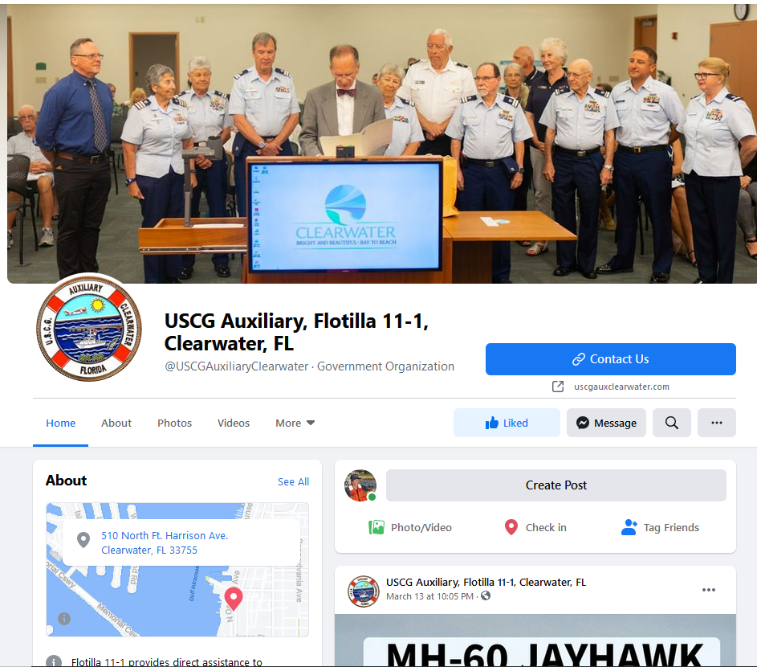
Facebook Page
https://www.youtube.com/watch?v=NIOo7bfzGSQ

Slide 27
Close the Sale
Set up dedicated contact numbers and sites for classes
Personally respond to every call to register student
Dedicated Phone – PE class only
Dedicated Email – PE class only
Dedicated Website or webpage – PE class only
Dedicated Registration – PE class only
Notes:
Closing the sale is as important as generating inquiries and interest from prospective students. Handling of the prospective student will make the difference.
The best way to make all the marketing pay off is to make sure to register each student who contacts us with interest. A “lost student” is an opportunity missed.
Virtual classes meant that the market for boating classes multiplied. The original market, face to face class, expanded to those interested in online classes which in turn exploded into the outer circle with video classes with CGAUX Instructors.
What happened to interest these boaters in our new virtual classes?
Whether they seek a NASBLA-approved state boating certificate or knowledge and skills gained directly from our experienced instructors, boaters seek to make their experience on the water safer for their families and more enjoyable for themselves.
Students are now connecting virtually from across the state and are no longer limited to driving distance. Families are taking the virtual classes together from the comfort of their homes. And students enjoy the interaction of seeing each other and the instructors on the video screen.

Slide 28
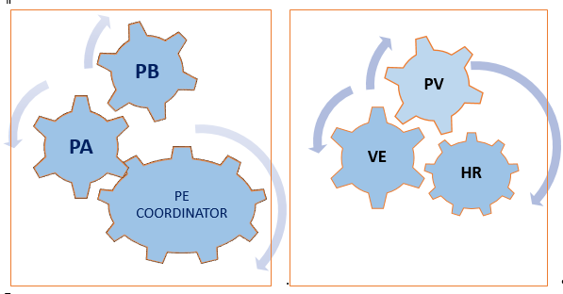
The Flotilla Team
Notes:
A smoothly functioning team of flotilla staff officers can achieve significant results with coordinated team work.
A clear website, a rich calendar with frequent multiple offerings, active Facebook friends, a targeted video, special interest articles with local community papers, local TV interview for the 5 and 10 pm news, local radio, boating, fishing hunting programs, and public service ads, all these offer steady opportunities.
And, above all, a friction-less sign up procedure where a knowledgeable Auxiliarist answers all inquiries personally and quickly, enrolling the inquiring boater seamlessly.

Slide 29
Maximizing PE
Check out our new webpage:
Virtual PE Classes Training and Resources
If you have questions, I hope to have answers
Karen.L.Miller@cgauxnet.us
727-365-0731 – Cell
You may email the E-Directorate at pe.feedback@cgauxnet.us
Notes:
Thank you for attending. If you have questions, here are my contact methods. Also, please spend the time to look at the E-Directorates Virtual PE Classes webpages

